Slide 1
The ChatBot Feels You -
A Counseling Service Using Emotional Response Generation
Presented By:
Ishraqul Islam - 19141008
Aqil Mahmud - 18341010
Fardin Rizvy Rahat - 17101245
MD. Shahriar Mim - 17101463

Slide 2
Contents From Paper
Abstract
Introduction
Related Works Included
Chat Assistant
Emotion Recognition Based on NLP
Personalize Response Generation
Conclusion

Slide 3
Overview
Counseling ChatBot
Cognitive Behavioral Therapy
Connecting To Therapists

Slide 4
INTRODUCTION
Human Emotional Recognition has been a long research topics
Introduction of Artificial Intelligence ( AI ) has adequate approach
Various emotion classification models are
Static Image Processing - Using Convolution neural networks (CNN)
Temporal Time Domain - Using Recurrent neural networks (RNN)
Machine Translation - Using Attention Network
For improved results we can follow hybrid approached multi modal classification
Not many applications apply the emotion recognition technique other than Apple Siri, Samsung S-voice, Google Now
Intelligent assistant services which applies very simple NLP techniques

Slide 5
WORKS DONE
EMOTION RECOGNITION
Features that indicates the emotional state of the user
Seven emotional states like happiness, anger, fear, sadness, surprise, disgust and neutral.
Robust face expression recognition.
Soft attention mechanism
Emotion embedding vectors
Limitations of existing emotion recognition

Slide 6
CHAT ASSISTANT FOR MENTAL HEALTHCARE
Capability of chatbot.
Deep interaction model.
Continuous various information
What the chatbot has to learn.
Emotional intelligent system
Smart mobile healthcare assistant

Slide 7
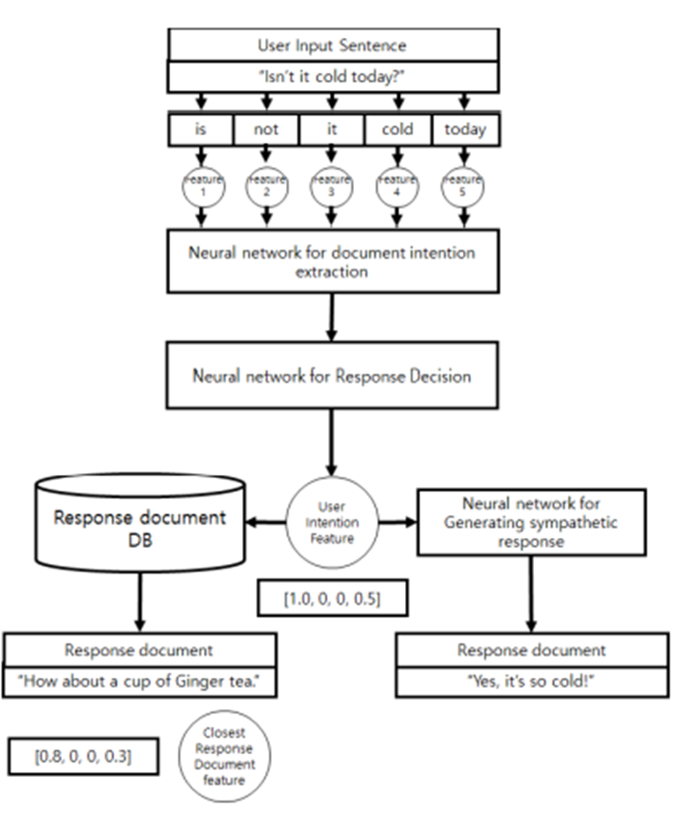
RESPONSE GENERATION
The Factors are:
Feature extraction
Response decision
Generating sympathetic response
Generating informative response.

Slide 8
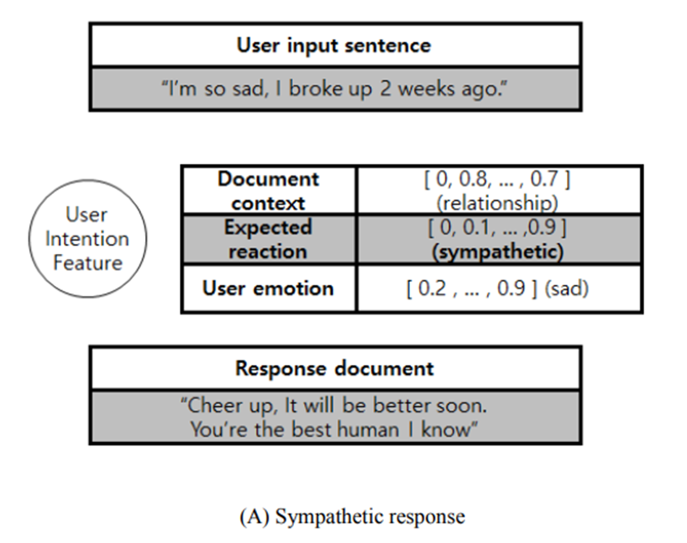
PERSONALIZED RESPONSE GENERATION
Personalizing response based different factors like person’s age, gender etc.
Dataset for User Intention :
Consists of document context and user emotion.

Slide 9
EMOTIONAL RECOGNITION BASED ON NLP
Why NLP ?
Gated Recurrent Unit(GRU) based Sentence Analysis
Data Representations of Emotions
Emotion Recognition Log
Pre-recognizing Emotions
Non-Functional: Ethical response

Slide 10
CONCLUSION
AI for Good
NLP
Psychiatric Counseling
A Better Mental Health

